Slide 1

Radical Collaboration: medical librarians, student scholarship & academic learning communities in the 21st century
Rebecca Raworth, University of Victoria
Lindsay Alcock, Memorial University of Newfoundland

Slide 2
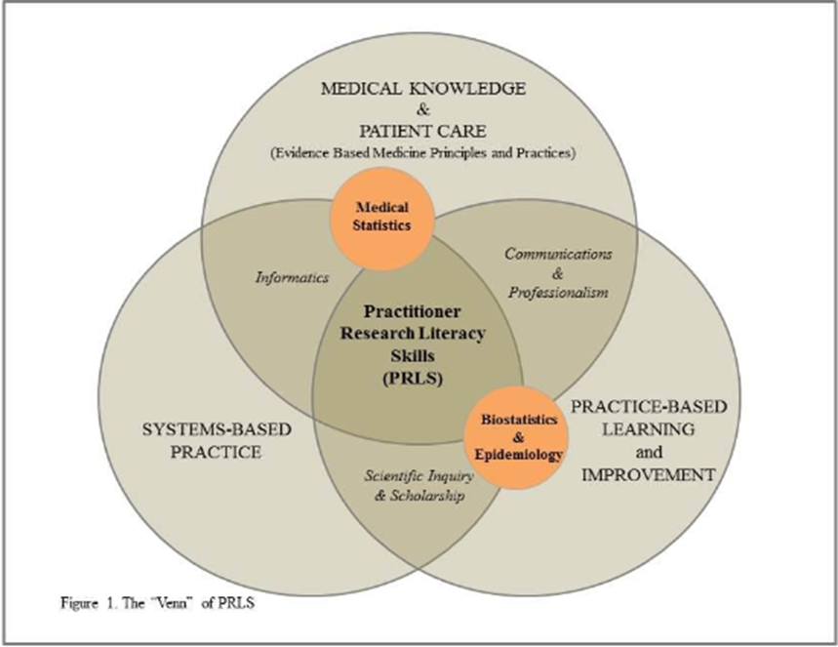
Medical Librarians as the “Venn” of Practitioner & Student Research Literacy Skills
From: Des Cruser, A., Brown, S. K., Ingram, J. R., Papa, F., Podawiltz, A. L., Lee, D., & Knox, V. (2012). Practitioner research literacy skills in undergraduate medical education: thinking globally, acting locally. Medical Science Educator, 22(3), 169.
Notes:
The title could also be Medical Librarians as the “Venn” of Practitioner & Student Research Literacy Skills

Slide 3
Objectives
To determine the extent of undergraduate medical program librarian involvement in student learning communities and in facilitating student achievement of scholarship and research competencies in American Association of Medical Colleges (AAMC) - accredited Canadian and American medical schools.

Slide 4
Questions
How many librarians are mentors (or equivalent) in undergrad academic learning communities?
How are librarians helping UG med students in achieving scholarship/research/info lit competencies?
How do Deans perceive librarians’ roles in helping students achieve scholarship and research competencies?

Slide 5
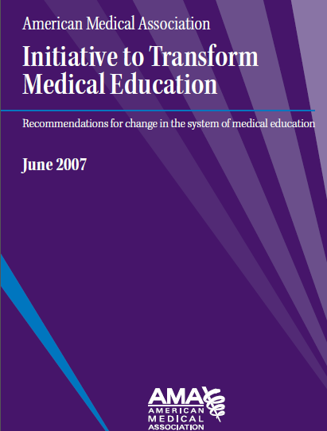
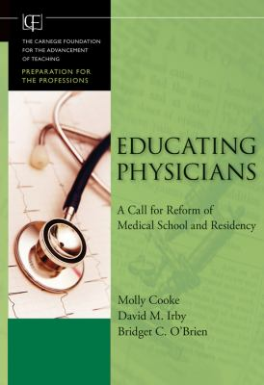
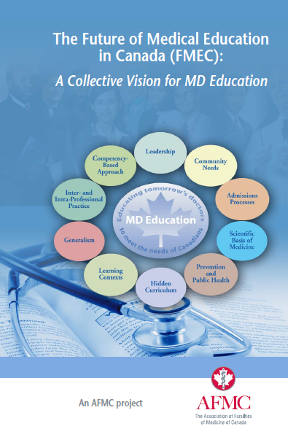
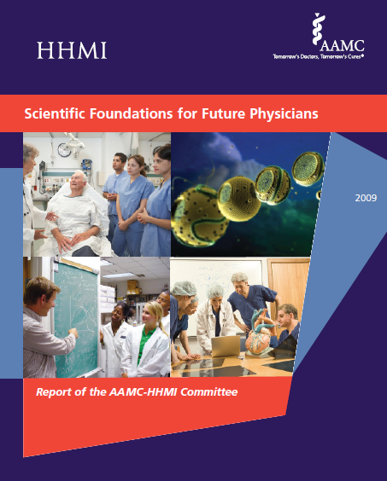
Why?
Notes:
The 2009 article, Defining and describing medical learning communities: results of a national survey by Ferguson et al, piqued our interest. Ferguson’s study reported that, among other things, that academic learning communities can be used to deliver curriculum, however, it did not mention any findings of academic learning communities used for scholarship or research purposes. In fact, Ferguson’s research finds that most student learning communities are used for social purposes. Willis and Deardorff, however, in 2011, wrote a paper suggesting that scholarship/research be a defined purpose of undergraduate student learning communities.
(Ferguson K J, Wolter EM, Yarbrough DB, Carline JD, Krupat E. Defining and describing medical learning communities: results of a national survey. Acad Med. 2009;84(11):1549-56.
Willis M, Deardorff A. Developing a research-focused learning community at one medical school. Med Sci Educator. 2011;21(1):98-103.)
The imperative for academic medical librarians to take on new roles in the 21st century academic enterprise. to remain relevant in the 21st century, librarians need to change the roles they play in the academic enterprise from service providers to ‘embedded’ members of research teams and student activities.
(American Library Association. The State of America's Libraries: A report from the American Library Association 2012 [Internet]. p. 29. [cited 2014 Dec 19]. Available from: http://www.ala.org/news/sites/ala.org.news/files/content/StateofAmericasLibrariesReport2012Finalwi thcover.pdf.)
Calls to reform undergraduate medical education to meet 21st century societal demands. All reports called for students to have more scholarship/research opportunities and for there to be more student-centred learning
There have been extensive recent calls nationally and internationally to reform the undergraduate medical education context from the Flexnerian model of medical education to a new paradigm. All of these reports make the following recommendations for revising the undergraduate medical education curriculum:
To move from a time-based educational paradigm to a competency-based paradigm
To increase opportunities for student scholarship and research
The Liaison Committee on Medical Education (LCME) states: “An institution that offers a medical education program should make available sufficient opportunities for medical students to participate in research and other scholarly activities of its faculty and encourage and support medical student participation.” (Liaison Committee on Medical Education. Functions and structure of a medical school: standards for accreditation of medical education programs leading to the M.D. degree. Liaison Committee on Medical Education. 2013. Available from: http://www.lcme.org/publications.htm#standards-section.)
To diversify learning contexts to ensure student learning takes into account the 21st century digital and more student-centred learning environment. The Carnegie Report by Cooke and Irby envisions a medical education system that…”creates opportunities for integrative and collaborative learning. Student learning contexts need to be diversified, “in part to ensure that online learning be a part of student curriculum and to ensure that students work in small groups or communities.” Kadmon G, Schmidt J, De Cono N, Kadmon M. (2011). Integrative vs. traditional learning from the student perspective. GMS Zeitschrift für medizinische ausbildung. 2011;28(2).
To better address the ‘hidden’ curriculum. The Future of medical education in Canada (FMEC): a collective vision for MD education report states that “Faculties of Medicine must therefore ensure that the hidden curriculum is regularly identified and addressed by students, educators, and faculty throughout all stages of learning.” (Association of Faculties of Medicine of Canada. The future of medical education in Canada (FMEC): a collective vision for MD education. Association of Faculties of Medicine of Canada, 2009: p.6. Available from: http://www.afmc.ca/future-of-medical-education-in-canada/medical-doctor-project/collective-vision.php.)
Finally, we could see that embedding librarians within student learning communities might address many of the concerns raised in the library and medical education literatures.
Cooke M, Irby DM, O’Brien BC. Educating physicians: a call for the reform of medical school and residency. Jossey-Bass/Carnegie Foundation for the Advancement of Teaching.
Vol.16. John Wiley & Sons.
Hager M, Russell S, eds. Revisiting the medical school educational mission at a time of expansion: a Conference Sponsored by the Josiah Macy, Jr. Foundation. Josiah Macy Jr. Foundation, 2009.
The Association of Faculties of Medicine of Canada. The Future of medical education in Canada (FMEC): a collective vision for MD education. Association of Faculties of Medicine of Canada, 2009. Available from: http://www.afmc.ca/future-of-medical-education-in-canada/medical-doctor-project/collective-vision.php.
General Medical Council. Education Committee. Tomorrow’s doctors: recommendations on undergraduate medical education. London: General Medical Council. 2009.

Slide 6
Definition: student scholarship
“…the appraisal, creation, dissemination, application and translation of medical knowledge, using both print and digital means”
Notes:
Knowledge creation
Critical appraisal
Research design
Information/data use
Knowledge management
Research papers

Slide 7
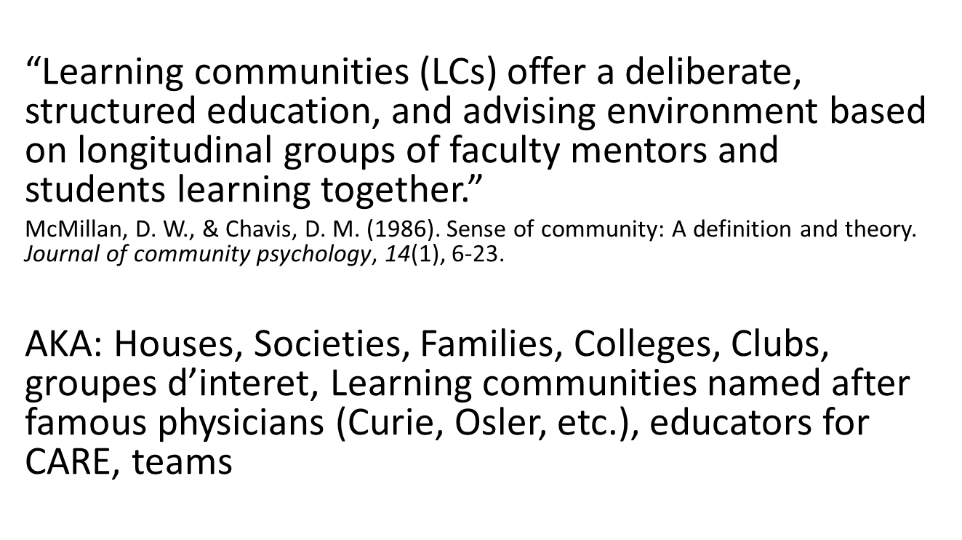
Definition: learning communities
Notes:
Primary goals of ALCs
Establish academic support networks
Fostering meaningful relationships
Professionalism
Social
Engagement in scholarship activities
Student support services
Interprofessional teamwork
Academic mentorship

Slide 8
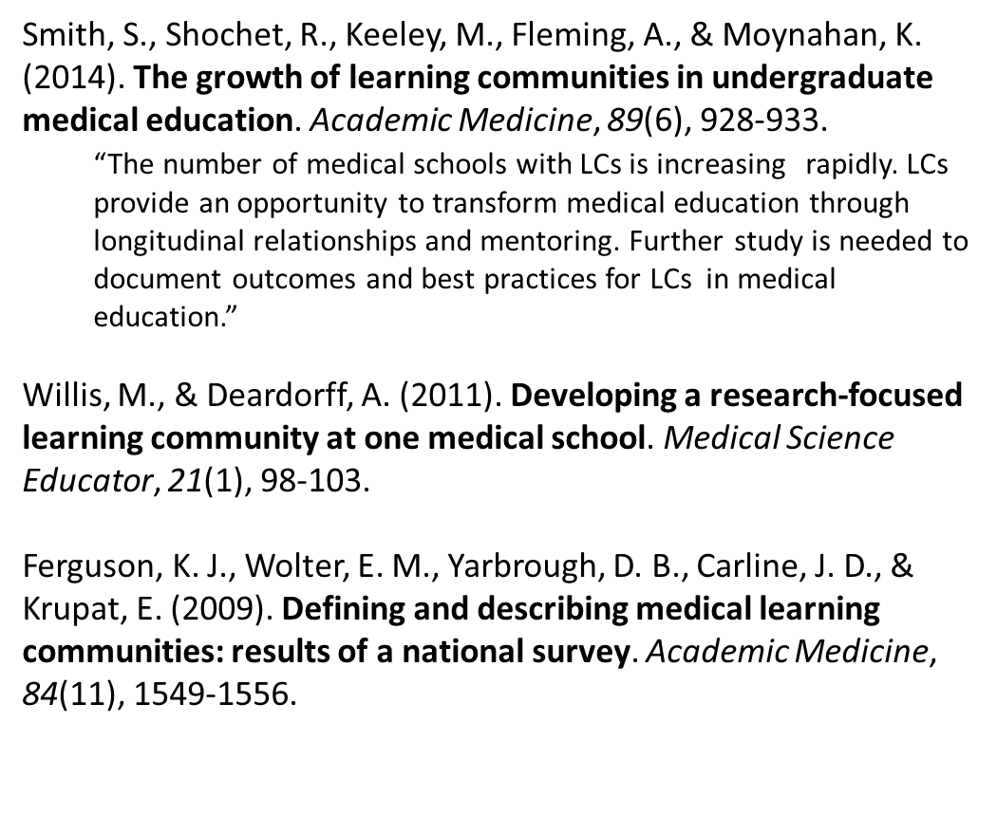
Literature
Notes:
LCs are about student-centred learning (small groups, longitudinal relationships)
It’s been said that LCs could address the “hidden curriculum” which is where librarians fit in.
Learning communities – modern movement in higher ed began in 1980s but not in med schools
Learning communities are associated with positive outcomes including student retention and academic achievement
57 North American medical schools belong to the Learning Communities Institute. The LCIs first met in 2005
Sunny Smith et al (2014) found, like Ferguson et al (2009) that most LCs address professionalism and social activities mentoring and social activities, clinical skills but not research/scholarship
-there is still not much literature on LCs in medical education
Ferguson et al Acad Med 2009 identified 18 LCs in UG med schools
Smith et al Acad Med 2014 identified 66 LCs in UG med schools with another 29 med schools considering them
Ferguson (2009) notes in her paper (Ferguson, K. J., Wolter, E. M., Yarbrough, D. B., Carline, J. D., & Krupat, E. (2009). Defining and describing medical learning communities: results of a national survey. Academic Medicine, 84(11), 1549-1556) , that a big challenge for learning communities in med ed is identifying enough clinical faculty to participate (time commitment, cost). That interested me as I thought perhaps librarians could be some of the mentors
The number of medical schools with learning communities is increasing rapidly. Learning communities provide an opportunity to transform medical education through longitudinal relationships and mentoring.
nt-centred learning = Learning Communities Institute

Slide 9
Design
Literature searches to inform surveys
Online surveys (validated)
  UGME Deans of Curriculum (North American)
  Librarians with appointments in UG medical schools (North America)
Ethics approval obtained from University of Victoria and Memorial University of Newfoundland
Notes:
The literatures (education, medical, librarianship) were searched for relevant articles published between 2009 & 2014. (We chose to begin our searches in 2009 in order, partly, to update the Ferguson survey of medical schools with academic learning communities.) Over 200 articles met our criteria and were read.
(Ferguson KJ, Wolter EM, Yarbrough DB, Carline JD, Krupat E. Defining and describing medical learning communities: results of a national survey. Acad Med. 2009;84(11):1549-56.)
Two exploratory, semi-structured, web-based surveys were developed using both closed and open-ended options. They each ran for three weeks. The surveys were informed, in part, and with the authors’ permissions, by adapting survey questions used in the following research:
Ferguson, K. J., Wolter, E. M., Yarbrough, D. B., Carline, J. D., & Krupat, E. (2009). Defining and describing medical learning communities: results of a national survey. Academic Medicine, 84(11), 1549-1556.
Haddow, G. (2012). Knowledge, skills and attributes for academic reference librarians. Australian Academic & Research Libraries, 43(3), 231-248.
Marz, R., Dekker, F. W., Van Schravendijk, C., O’Flynn, S., & Ross, M. T. (2013). Tuning research competences for Bologna three cycles in medicine: report of a MEDINE2 European consensus survey. Perspectives on medical education, 2(4), 181-195.
One survey is designed for medical librarians with appointments in AAMC-accredited undergraduate medical schools; the other is designed for Deans of Curriculum (or equivalent) at AAMC-accredited undergraduate medical schools. The surveys both focus on the character of student learning communities at AAMC-accredited Canadian and American undergraduate medical schools; their focus, or not, on student research and scholarship learning outcomes; and the role(s), if any, of librarian members of learning communities.

Slide 10
Setting
AAMC accredited Canadian (17) and American medical schools (141) = 158
Undergraduate medical education

Slide 11
Subjects
Librarians associated with undergraduate medical school programs in Canada and the United States
Deans (or equivalent) of undergraduate medical school programs in Canada and the United States

Slide 12
Methods
Invitation to participate via emails to listservs
Email includes introduction, implied consent, and link to survey
Survey open for 3 weeks
Data downloaded, cleaned and analyzed

Slide 13
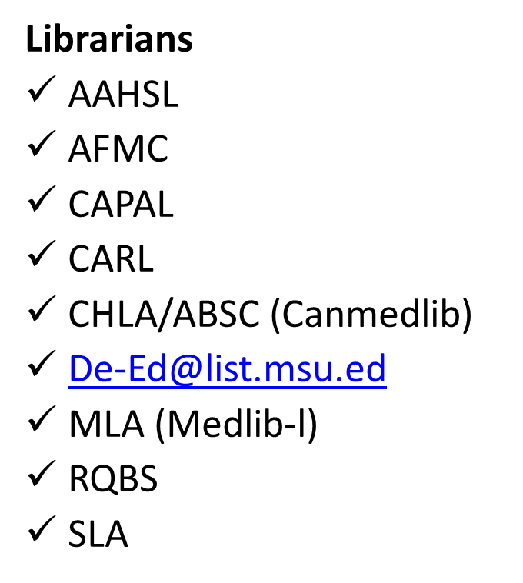
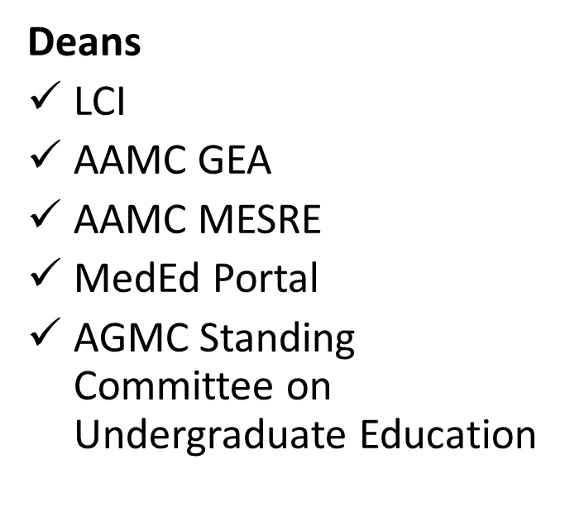
Survey invitation
Notes:
NOTE: challenge with Dean’s survey distribution is that all the listserves are closed. Had to ask moderator to post on our behalf.
Therefore, no way to determine exactly who received the survey. No response of receipt of request email from any moderator until I asked a second time, after which one person said he had already sent it out. He sent it out again, still no response. Also asked Associate Dean (UGME) at MUN to send to listservs on our behalf.

Slide 14
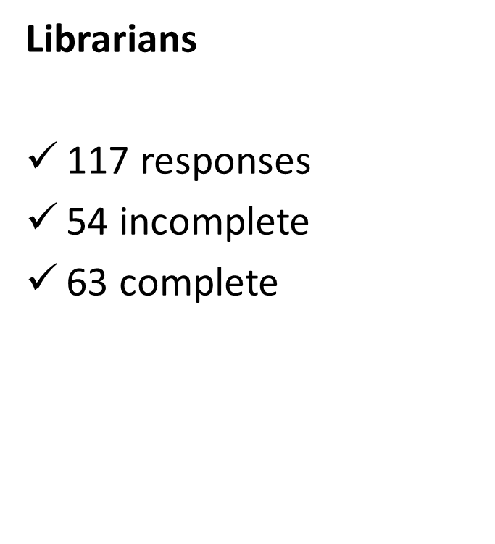
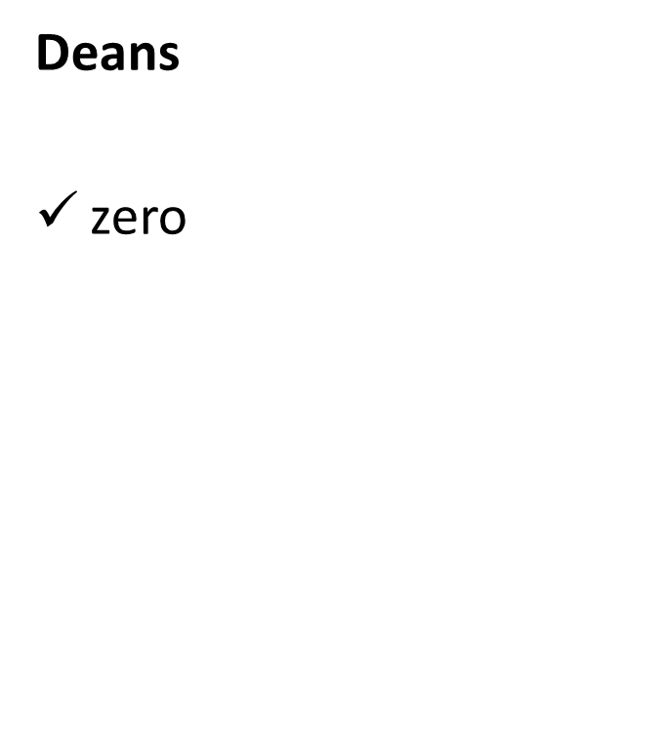
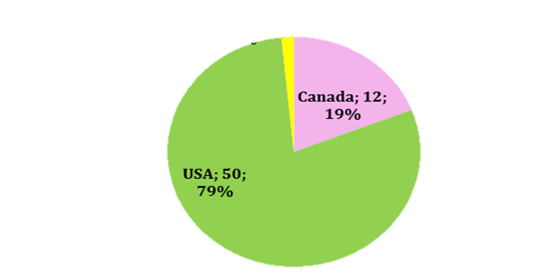
Response rates
Notes:
Incomplete surveys still held valuable responses and feedback so decided to include them in data analysis(??????)

Slide 15
Librarians assigned as ALC members?
“House librarian” i.e. on demand
Instruction/Seminars
Mentor in SLC group / program leader
Volunteer
Informal mentor
Reference librarians for learning communities for first year students
Notes:
Volunteer in student-led community (women in medicine, LGBT community, diversity)
Respondents confused formal SLCs with informal reference and instruction

Slide 16
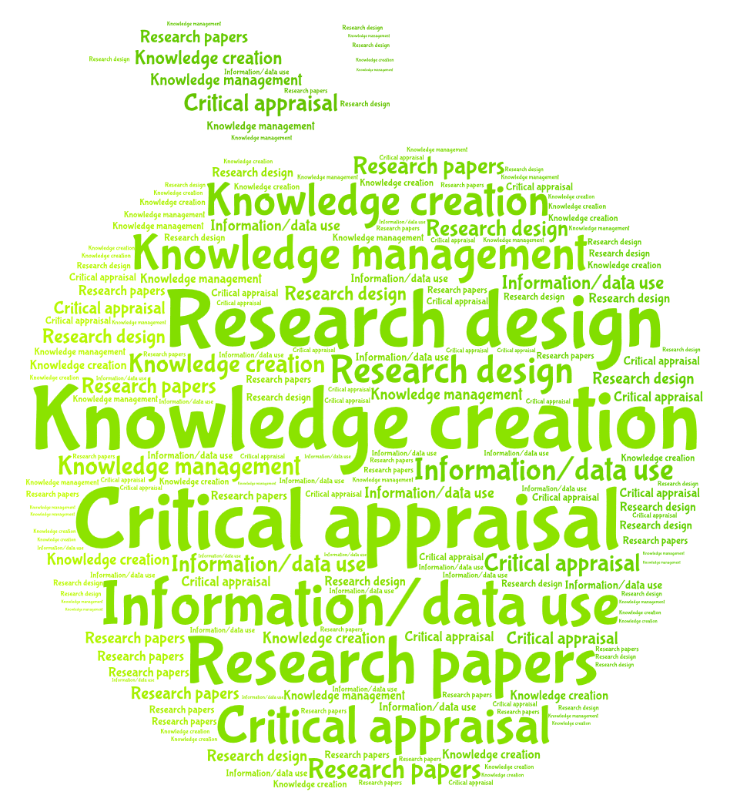
Scholarship activities
71%: current dedicated curricular time
52% planned dedicated curricular time in the near future (37% blank)
Notes:
High percentage knowledgeable of dedicated curricular time indicates familiarity with curriculum whether involved or not.
Knowledge creation = conference papers/presentations/publications/posters
Knowledge management = current awareness/citation management/online bibliographic management
Facilitated by Teaching faculty (52%), medical librarians(40%), research faculty, clinician researchers, clinicians, other.

Slide 17
Formal mentorship?
75% NO
“regular in person meetings”
Office consults
Seminar teaching
“student will come learn how to search PubMed”
analysis of literature searches
“evaluate search assignments”
Consults via email
Skype

Slide 18
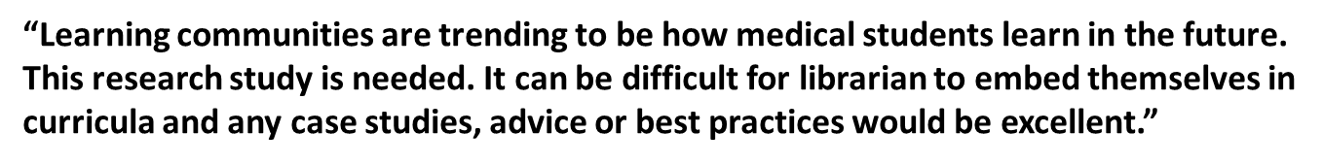
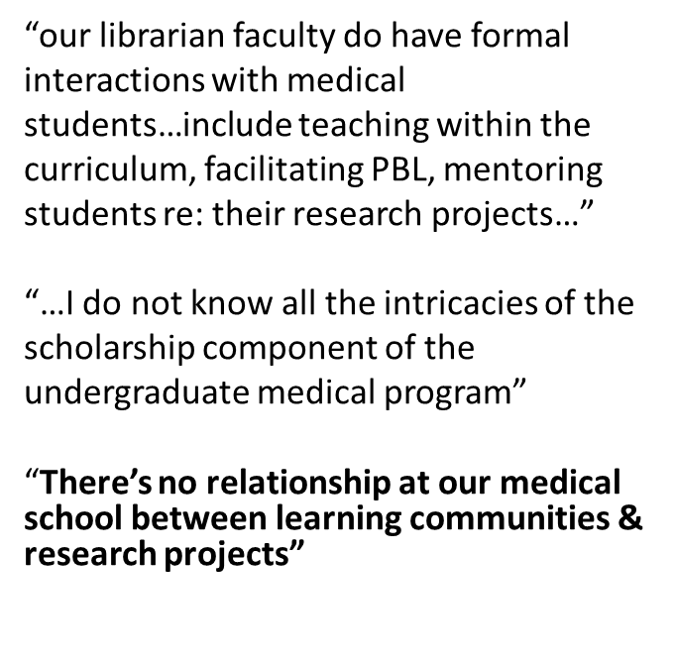
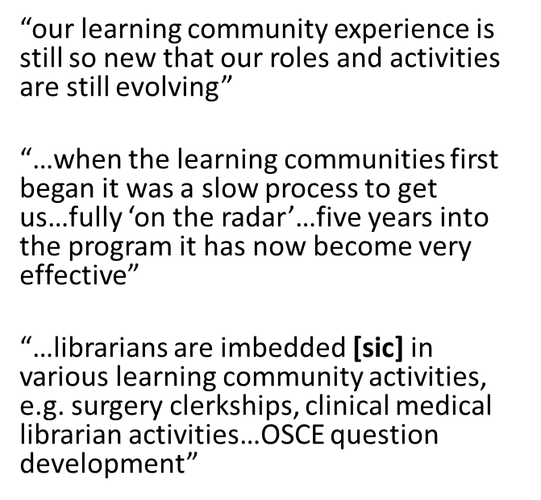
Participant comments
Notes:
Lindsay, if you could put these quotes into speech bubbles that would look better. I tried but couldn’t successfully make them look good.

Slide 19
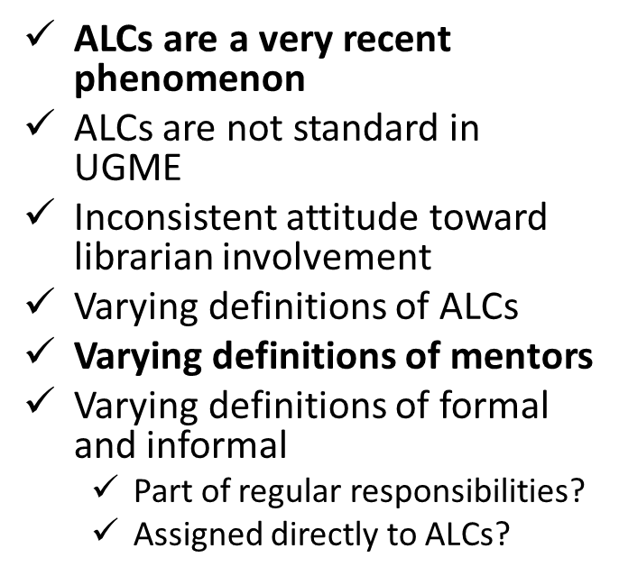
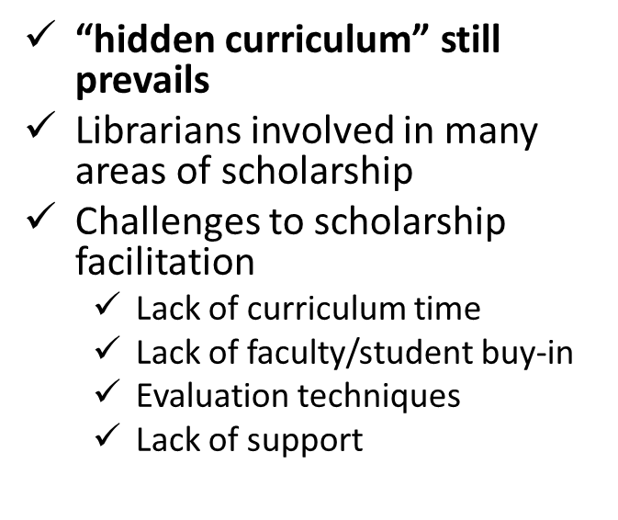
Observations and take-aways
Notes:
Add to slide:
some referred to formal involvement in terms of helping students with literature searches, answering questions through email, etc….these are every day responsibilities but are NOT intentionally designated roles in consistent learning communities. This is important.
It is also clear that there are many librarians who work in libraries associated with ugme who do not know what is going on in their curricula in terms of ALCs and scholarship.

Slide 20
Acknowledgements
Canadian Association of Research Libraries (grant)
Chelsea Garside, Assessment Resource Officer (UVic)
In-In Po, Assessment Resource Officer (UVic)
Christine Walde, Grants & Awards Librarian (UVic)
authors K.J. Ferguson, C.M. Dewey, G. Haddow, and R. Marz who allowed us to make use of their previously published surveys.

Slide 21
Thank YOU!
Notes:
DO YOU HAVE ANY QUESTIONS?

Slide 22
Questions?

